Slide 1
St. Edward’s University
Web Tour
College Prep
Mr. Gordon
jgordon@bisdtx.org

Slide 2
Upcoming Events
We have a lot of upcoming events. Please mark these on your calendar.
hi

Slide 3
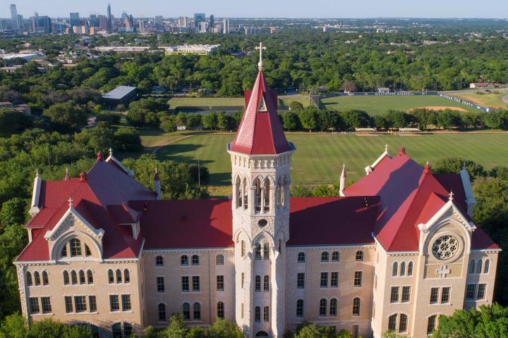
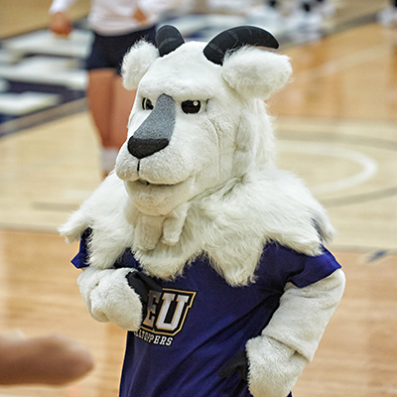
St. Edward’s University Facts
St. Edward’s is located in Austin, TX, overlooking the city.
St. Edward’s is a private university.
They are the St. Edward’s Hilltoppers and their mascot is Topper the goat. (Because they are on top of a hill.) ¯\_(ツ)_/¯
I am an alumnus, meaning I graduated with my master’s degree from there.
hi

Slide 4
St. Edward’s University Facts
St. Edward’s was founded in 1885 and has 2,870 undergraduate students.
Ranked #8 out of 120 Regional Universities in the West by US News and World Report
Has a 62.3% graduation rate
The Main building looks like Mario’s castle
hi

Slide 5
SEU Majors and Virtual Tour
Read through one of the majors you are interested in.
Majors and Minors
Now take a virtual tour of the campus here
And
then take a virtual tour of a residence hall here
hi

Slide 6
College Prep Assignment
In the comments section of today’s College Prep,
answer the following question:
hi

